Slide 1
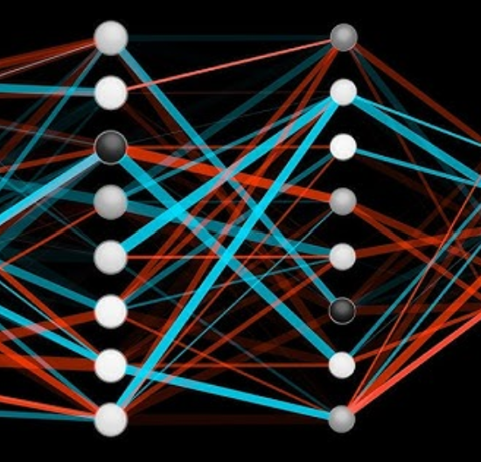
·
Predicting Colorectal Cancer
Subtypes using a Feedforward Neural Network
A compact MLP workflow for CMS2 classification from high-dimensional gene expression data
Luca Baldi & Serna Sürer

Slide 2
Task & motivation
From heterogeneous tumors to a clear binary prediction task
WHY THIS TASK MATTERS
CMS2
Colorectal cancer is biologically heterogeneous. CMS subtypes summarize molecular patterns that can differ across patients.
Gene expression
features
MLP
classifier
non-CMS2
Key question
Can selected expression patterns separate CMS2 from the combined non-CMS2 group?
CRC CMS2 prediction · PyTorch MLP
01

Slide 3
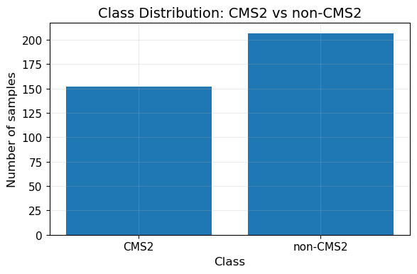
Dataset & binary target
359 tumor samples · 56,271 gene-expression features · moderately imbalanced classes
359
56k+
500
samples
gene features
selected genes
Binary recoding
CMS2 is the positive class; CMS1, CMS3 and CMS4 are grouped as non-CMS2.
Moderately imbalanced
The classes are not perfectly balanced, so balanced accuracy, precision, recall, F1-score and ROC-AUC are reported.
Class counts: CMS2 = 152 · non-CMS2 = 207
CRC CMS2 prediction · PyTorch MLP
02

Slide 4
Preprocessing pipeline
The high-dimensional input is reduced and standardized before training
Merge
expression + CMS labels
Stratified split
train / val / test
Remove constant
genes
ANOVA F-score
select top 500
Standardize
features
Train/validation/test split
Why feature selection?
Why scaling?
251 / 54 / 54 samples. The test set is kept separate for final evaluation.
56,271 genes with only 359 samples creates a high overfitting risk.
Neural networks train more reliably when input features have comparable scales.
CRC CMS2 prediction · PyTorch MLP
03

Slide 5
Model: compact PyTorch MLP
A simple feedforward network turns 500 selected gene values into one CMS2 probability
Input
500 genes
Hidden layer
128 + ReLU
Dropout
30%
Hidden layer
64 + ReLU
Output
1 logit
Training setup
Loss: binary cross-entropy with logits
Optimizer: Adam
Regularization: dropout + weight decay
Early stopping based on validation loss
CRC CMS2 prediction · PyTorch MLP
05

Slide 6
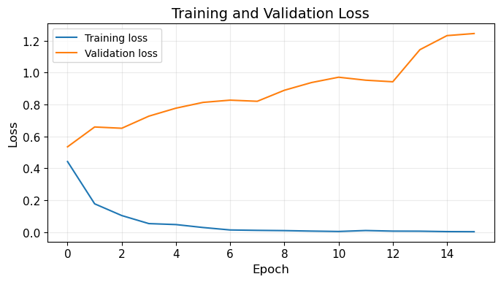
Training behavior
Validation loss reveals overfitting, so the best checkpoint is selected early
WHAT THE CURVE SHOWS
Training loss drops quickly.
Validation loss increases after the first epochs.
This is a clear overfitting signal.
Response
Early stopping keeps the model state with the lowest validation loss instead of the last epoch.
CRC CMS2 prediction · PyTorch MLP
06

Slide 7
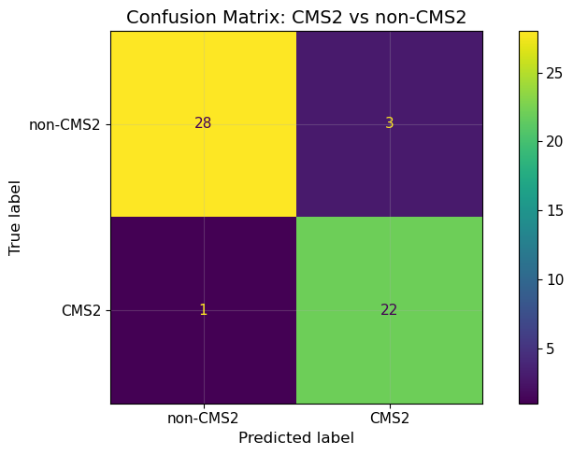
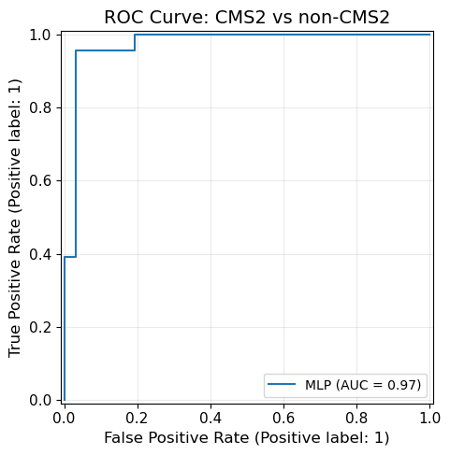
Final test-set performance
The selected model classifies most held-out samples correctly
0.926
0.930
0.917
0.973
Accuracy
Balanced accuracy
F1-score
ROC-AUC
Only 4 of 54 test samples are misclassified: 3 false positives and 1 false negative.
AUC ≈ 0.97 indicates strong separation on the held-out test split.
Confusion matrix
ROC curve
CRC CMS2 prediction · PyTorch MLP
07

Slide 8
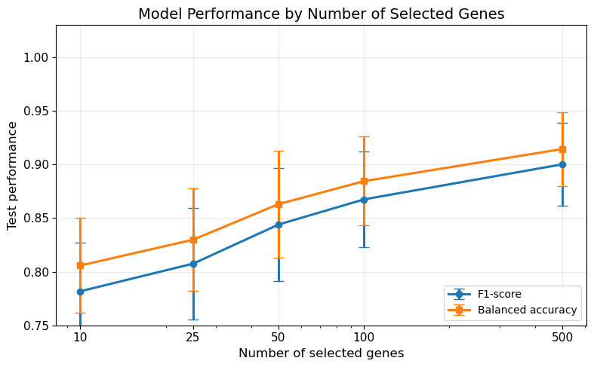
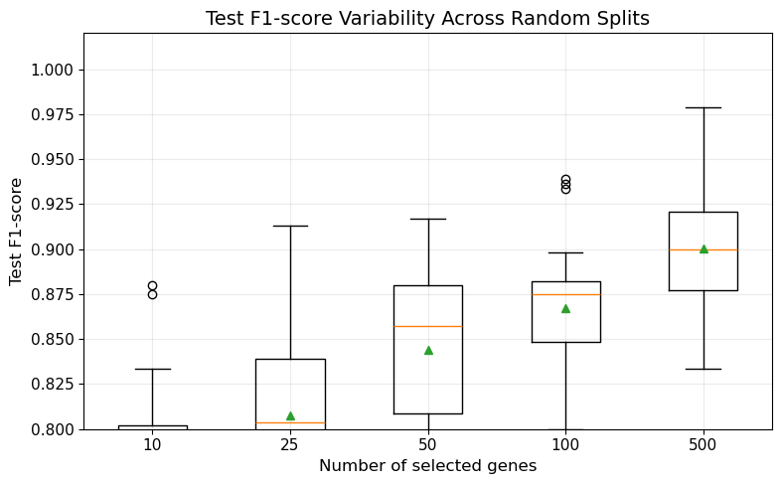
Robustness experiment
Performance improves and stabilizes when more selected genes are used
Experiment design
Result
Interpretation
Five feature counts were tested across multiple random splits: 10, 25, 50, 100 and 500 genes.
Using 500 selected genes gives the highest mean F1-score and balanced accuracy.
CMS2 prediction benefits from a broader gene-expression signature rather than only a few genes.
CRC CMS2 prediction · PyTorch MLP
08

Slide 9
Conclusion & limitations
MAIN CONCLUSION
A compact PyTorch MLP can learn reproducible CMS2-related patterns from selected gene-expression features.
1 · Good test performance
2 · Overfitting remains visible
3 · Feature selection matters
The model achieved high F1-score and ROC-AUC on the held-out test split.
The validation loss curve shows why dropout, weight decay and early stopping are necessary.
Robustness experiments support the final 500-gene setting.
Further work
Compare with simpler baselines such as logistic regression or random forest
Validate on an external CRC cohort
Extend from binary CMS2 prediction to all CMS subtypes
CRC CMS2 prediction · PyTorch MLP
09

Slide 10
Thank you
Questions?
Luca Baldi & Serna Sürer

